Slide 1

Clearwater State University

Slide 2

The Project
Model building to identify students with higher early attrition risk and recommendation of appropriate interventions based on the analysis

Slide 3

Important Features
Student came back to First semester in 2nd year
Age of the Student Enrolled
Gender of the student
Background of Student
Student is in same state as university
Student is an International Student
Student is staying in campus or outside
Student's High School GPA score
Student's score calculated both on Entrance1 & Entrance2 score
Degree for which student has enrolled in university
Student's Major course in University
Student’s First Term Status
Student’s Second Term Status
Father's educational status
Mother's educational status
Course Fees
Estimated Family contribution towards course fees
Note
The Highlighted points are
very important Features for
deciding student’s early
Attrition rate

Slide 4
01 | Student came back to First semester in 2nd year
This many data we have to know the attrition rate of Clearwater State University
73%
Returned
Out of 3400 students 723 student did not show up in second year
The percentage of student leaving without completing their course is very high
As we move forward we get to know which of the attributes affecting the attrition rate
27%
Not Returned

Slide 5
02 | Age of the Student Enrolled
Age Distribution
1%
99% of the student are young.
They lies between age 16 to 20 years
6%
93%
Dividing into two groups Returned for Second year and not Returned and remaking the bar chart
20.5 percent of the student of age between 16 to 20 years don’t shows for the second year
Its seems like age does not play an important role to predict attrition
1%
5%
1.5%
74%
19%
Not Returned

Slide 6
03 | Gender of the student
Out of 3400, 1260 students are male and 2140 are female
It’s good to see that more female student are educating themselves
37% MALE
63% FEMALE
Out of 3400, 2140 students are female, out of that 1597 students are of age group between 16 to 18 years who returned for second year and 444 female student did not show up
14% of the female student did not came for second year
Out of 1260 male student, 920 student are of age 16 to 18 years who returned for second year and 216 male student did not show up
7.4% of the male student did not came for second year
Age group | Returned | Not Returned
16-18 | 47.0% | 13.1%
19-20 | 1.9% | 0.8%
21-26 | 0.1% | 0.1%
Age group | Returned | Not Returned
16-18 | 27.1% | 6.4%
19-20 | 2.4% | 0.9%
21-26 | 0.3% | 0.1%
14%
Not Returned
7.4%
Not Returned

Slide 7
04 | Background of Student
BGD 1
BGD 3
BGD 4
BGD 2
BGD 6
BGD 7
BGD 5
BGD 8
2082
61.2%
947
27.9%
139
4.1%
106
3.1%
94
2.8%
19
0.6%
8
0.2%
5
0.1%
89.1 percent of the student came from background 1 and 3
96.3 percent of the student came from background 1 , 3, 4 and 2
99.1 percent of the student came from background 1 , 3, 4, 2 and 6
It is clearly seen that student are less from background 5,7 and 8.
Some of the reasons could be due to poor financial status or lack of proper information
Government and state university should act together to overcome this problem

Slide 8
05 | Student is in same state as university
90 %
SAME STATE
3063 number of student are from the same state as university is.
This may be one of the reason of having less number of student living inside the campus
10 %
DIFFERENT STATE
337 number of student are from the different state.
This include both student from same country and different country.

Slide 9
06 | Student is an International Student
28
INTERNATIONAL
STUDENT
The count of international student is very low
Perhaps University should act seriously to attract international student

Slide 10
07 | Student is staying in campus or outside
42%
ON CAMPUS
1420 number of Student are living inside the campus and 1980 are living outside the campus
Many of the student are not choosing university campus
One way to make more student opt for university campus is enhance hostel facilities and lower boarding and lodging charge.
58%
OFF CAMPUS

Slide 11
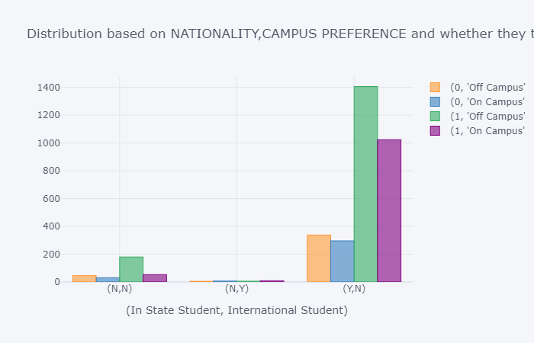
1
 |  | Not Returned |  | Returned
Same State Student | International Student | Off Campus | On Campus | Off Campus | On Campus
No | No | 1.35% | 0.91% | 5.29% | 1.56%
 | Yes | 0.15% | 0.21% | 0.18% | 0.26%
Yes | No | 9.94% | 8.71% | 41.35% | 30.09%
9.11 percent student share same country but different state
Out of that, 1.35 percent Off Campus students did not return for second year and 0.91 percent On campus student also did not return.
5.29 percent off campus student Returned and 1.56 percent on campus student returned
2
The off campus student are more in both returned and not returned case
0.8 percent international student
Out of that, 0.44 percent students returns
The percent is very low and need to be taken care
3.
3
9.94 percent off campus student and 8.71 percent On Campus student did not return for second year
41.35 percent off campus returned and 30.09 percent on campus student returned
1.
2.
No, No
No, Yes
Yes, No

Slide 12
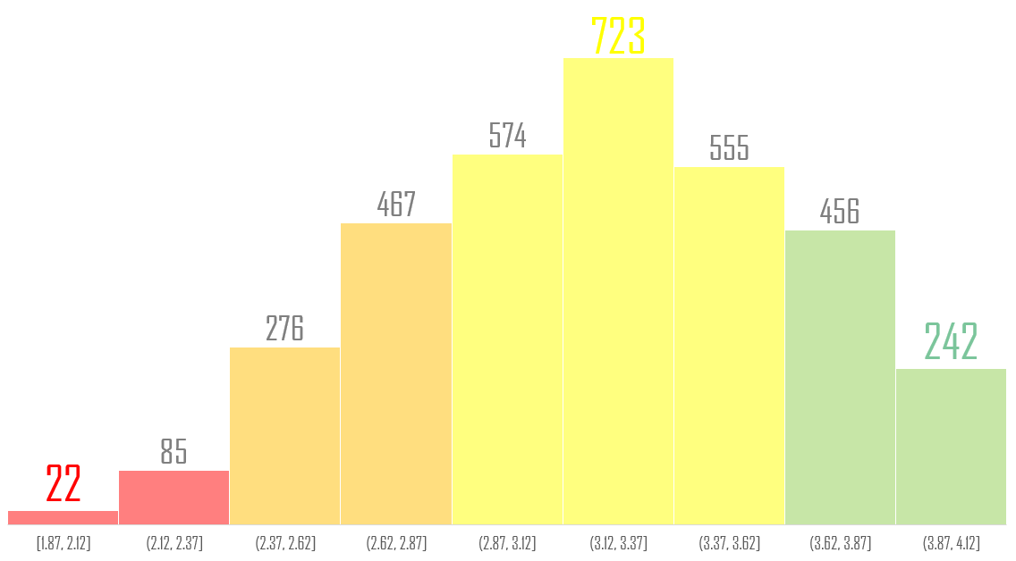
08 | Student's High School GPA score
We have 107 very poor performing student
743 student performance are below average
1852 student are average performing
And 698 student are having high GPA
Student’s High School GPA Distribution

Slide 13
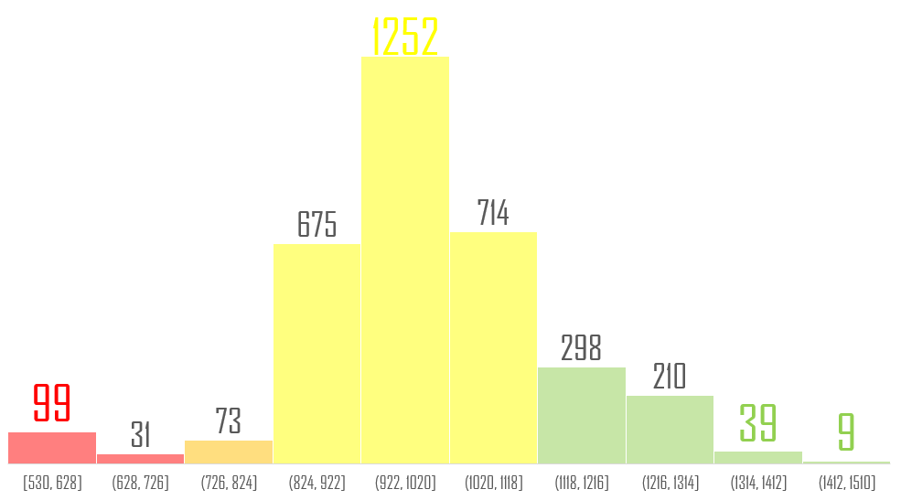
09 | Student's score calculated both on Entrance 1 & Entrance 2 score
We have 130 very poor performing student
73 student are below average
2641 student performs average in entrance exam
556 student have high score in entrance exam. Out of that 48 student are having very high score.
Combined Score Distribution

Slide 14
There are student who have poor GPA but performs good in entrance exam.
On the other hand there are student who have very good GPA but poor performance in entrance exam

Slide 15
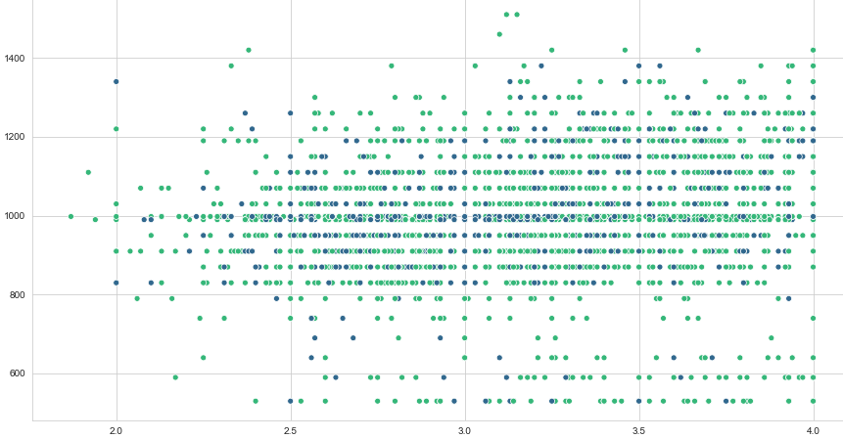
Student ‘s High School GPA against Combined Entrance test Score
Returned
Not Returned
There are student having very good score both in GPA and entrance exam leaving the university
On the other hand, there are student whose both GPA and entrance score are low but staying for the second year

Slide 16
10 | Degree for which student has enrolled in university
BACHELORS
3384
ASSOCIATE
12
CAREER ASSOCIATE
4

Slide 17
11 | Student's Major course in University
Row Labels | Count of Student | Percentage
Biology | 362 | 10.6
Early Childhood Education | 190 | 5.6
Pre-Nursing | 177 | 5.2
Nursing | 164 | 4.8
Psychology | 155 | 4.6
Pre-Business | 133 | 3.9
Theatre Arts | 131 | 3.9
Music Performance | 99 | 2.9
Criminal Justice | 98 | 2.9
Music Education | 96 | 2.8
General Business | 85 | 2.5
Exercise Science | 81 | 2.4
Miscellaneous | 1629 | 47.9
Total Major course in university 54
This shows the diversity of the university
The left hand side table shows the top 12 most opted major course by student
This includes those subject which has count less than 80 such as:
English and Secondary Ed’
Exercise Science
General Business
Mathematics and Secondary Ed etc.

Slide 18
Rate of attrition of student among different major subject
Table
Major Subject | Not Returned | Returned | Fraction not returned | Fraction returned
Biology | 82 | 280 | 0.23 | 0.77
Criminal Justice | 29 | 69 | 0.3 | 0.7
Early Childhood Education | 37 | 153 | 0.19 | 0.81
Exercise Science | 19 | 62 | 0.23 | 0.77
General Business | 12 | 73 | 0.14 | 0.86
Miscellaneous | 353 | 1276 | 0.22 | 0.78
Music Education | 8 | 88 | 0.08 | 0.92
Music Performance | 12 | 87 | 0.12 | 0.88
Nursing | 37 | 127 | 0.23 | 0.77
Pre-Business | 32 | 101 | 0.24 | 0.76
Pre-Nursing | 47 | 130 | 0.27 | 0.73
Psychology | 43 | 112 | 0.28 | 0.72
Theatre Arts | 12 | 119 | 0.09 | 0.91
For example
Biology :
There are 362 student of biology, out of which 82 that is 23% not returned for second year and 280 that is 77% returned for second year

Slide 19
Rate of attrition of student among different major subject
Visualization
Returned
0.77
0.77
0.76
In many case rate of attrition is greater than 0.2
One of the reason could be lack of interesting topic inside the particular subject or teaching method is not so communicative to deliver knowledge effectively
Use current technology such as Virtual Reality to make student develop more interest towards their respective subject
0.77
0.78
0.73
0.72
0.7
0.3
0.28
0.23
0.22
0.27
0.23
0.23
0.24
Not Returned

Slide 20
12 | Student’s First Term Status
In the data set there were two columns containing “Grade points attempted by Student in First semester” and “Grade points earned by Student in First semester”. First term status columns is just the difference of the above two columns. The values came out to be less than zero, zero and greater than zero. Negative value were replaced by zero and than zero replaced by complete where positive values were replaced by not complete
60 %
COMPLETE
2040 number of student have completed their first term
40 %
NOT COMPLETE
1360 number of student have not completed their first term
Student not completing their first term’s percentage is not low enough to be ignored.
This also shows the lack of interest of student towards their career

Slide 21
13 | Student’s Second Term Status
57.5 %
COMPLETE
In the data set there were two columns containing “Grade points attempted by Student in Second semester” and “Grade points earned by Student in Second semester”. Second term status columns is just the difference of the above two columns. The values came out to be less than zero, zero and greater than zero. Negative value were replaced by zero and than zero replaced by complete where no zero values were replaced by not complete.
Missing values were replaced by not attend
1955 number of student have completed their first term
6 %
NOT ATTEND
209 number of student have not attend
36.5 %
NOT COMPLETE
1236 number of student have not completed their first term
Student not completing their second term and not attending their second term together makes up to 42.5 percent which is high enough to get the attention.
This may lead to high attrition rate

Slide 22
Degree | First term status | Second term status | Not Returned | Returned
Bachelors | Complete | Complete | 217 | 1153
 |  | Not Attempt | 89 | 12
 |  | Not Complete | 104 | 454
 | Not Complete | Complete | 82 | 492
 |  | Not Attempt | 90 | 18
 |  | Not Complete | 138 | 535
Associate | Complete | Complete |  | 7
 |  | Not Complete |  | 1
 | Not Complete | Complete |  | 1
 |  | Not Complete | 2 | 1
Career Associate | Complete | Complete | 1 | 2
 | Not Complete | Not Complete |  | 1

Slide 23
Total 101 student
88.1 percent student did not returned
11.9 percent student returned
Total 558 student
18.6 percent student did not returned
81.4 percent student returned
Returned
Not Returned
Total 1370 student
15.8 percent student did not returned
84.2 percent student returned
Total 574 student
14.3 percent student did not returned
85.7 percent student returned
Total 108 student
83.3 percent student did not returned
16.7 percent student returned
Total 673 student
20.5 percent student did not returned
79.5 percent student returned

Slide 24
Father's educational status | 14
15 | Mother's educational status
2.9 %
Middle School/Junior High
2.1 %
Middle School/Junior High
39.3 %
High School
36.0 %
High School
38.5 %
College/Beyond
44.1 %
College/Beyond
19.4 %
Other/Unknown
17.8 %
Other/Unknown

Slide 25
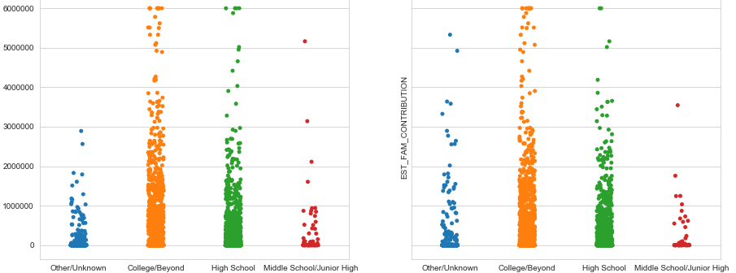
Parent’s education against Parent’s contribution
Parents having higher education are engaging their children more in education and lots of contribution are seen on their behalf
Father’s education
Mother’s education

Slide 26
16 | Course Fees
Most of the degree course is Bachelors
From the graph it is clearly seen there are five groups
1st group course fee is zero
2nd group course fee range till 500000
3rd group ranges from 500000 to 1000000
The 4th one ranges from 1000000 to 1500000
The last one is having very less number of count as course fee is very high
There are many such student which do not have course fee
Either the student got scholarship or his or her course is free of cost

Slide 27
17 | Estimated Family contribution towards course fees
There are many such student which do not have course fee
So data having zero value is not taken into account for preparing scatter plot
(As course fee is zero, therefore family contribution is also zero)
There are many cases where family contribution is below 3000000

Slide 28
COURSE FEE | Count | Not Returned | Returned | Percentage Not Returned | Percentage Returned
0 | 1679 | 347 | 1332 | 20.7 | 79.3
0-500000 | 265 | 62 | 203 | 23.4 | 76.6
500000-1100000 | 251 | 82 | 169 | 32.7 | 67.3
1100000-1500000 | 1199 | 229 | 970 | 19.1 | 80.9
>1500000 | 6 | 3 | 3 | 50.0 | 50.0
FAMILY CONTRIBUTION | Count | Not Returned | Returned | Percentage Not Returned | Percentage Returned
0 | 2112 | 456 | 1656 | 21.6 | 78.4
0-500000 | 584 | 129 | 455 | 22.1 | 77.9
500000-1100000 | 337 | 63 | 274 | 18.7 | 81.3
1100000-1500000 | 164 | 36 | 128 | 22.0 | 78.0
>1500000 | 203 | 39 | 164 | 19.2 | 80.8

Slide 29
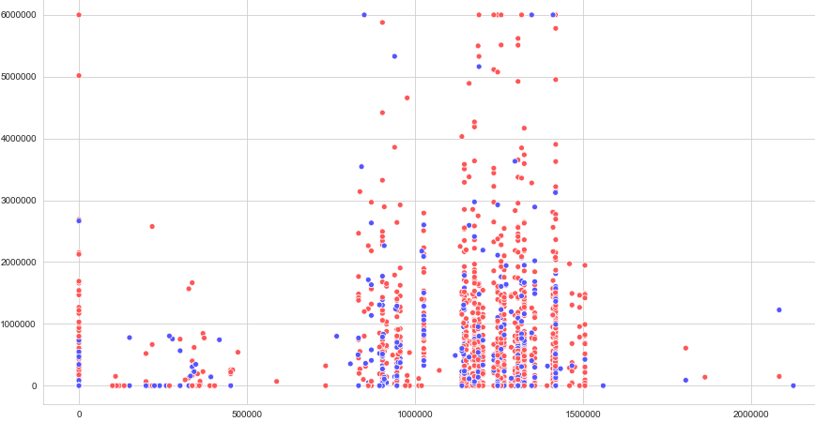
Course Fee against Family contribution
Returned
Not Returned
Even though the course fee is zero attrition rate is high
Most of the crowd are situated here as course fee ranges from average to a bit costly, but we can see 19.1 percent student did not returned
The family contribution ranges from high to low, more seen on the lower side
Highest attrition rate is seen here about 32..7 percentage
The family contribution is also low
With some of the points on the higher side
Course fee is very high therefore less number of student

Slide 30

Model Building
GRADIENT BOOSTING CLASSIFIER

Slide 31
After building the model, hyper tuning the parameters and fitting data into the model we got different weightage for different attributes
Top 10 most weighted attributes
Best Parameters:
Learning rate=0.1
Maximum depth of tree=3
Minimum number of samples required to split the node=3
Max features required to start a tree='sqrt’
Maximum number of tree build in the model=142
Sub sampling ratio of the dataset=0.75
The model able to predict the attrition risk with 83 percent accuracy and able to explain 84 percent of the variability present.

Slide 32

Those student who did not attempt or not completed second term are more prone to leave the university.
Conclusion
Grand extra time period to complete both first and second terms
Put a congratulation prize for those student who completes both the terms of first year
Student with high GPA as well as high test entrance score are more interested in further study.
Give scholarship to those student who are good in their academic curriculums
Some of the course fee are high as student are leaving because of less family contribution.
Involve government and other organization to invest in the university
Support middle class and lower class background student by organizing a charity fund event where people are asked to voluntary contribute for the great benefits.
Student age also matter as most of the student are of 18 years old.
Make course duration more flexible such that student don’t have to worry about their age

Slide 33
There are lots of Major subject where fraction ratio of not returning for second year is greater than 0.2.
Make the subject more interesting
Relate some real life example with the subject
Adopt new learning technology such as Virtual reality
Invite more other university’s professor as visiting professor so that knowledge can be shared among student
Collaborate with other state or country university
Send Student to other university in student exchange programs
Parents with higher education level are supporting their son/daughter more financially. This is not the case for less educated parents.
Advertising plays the key role here
Make people aware of the diverse as well as affordable course offered by university.
Print advertisement in the news paper
make pamphlets
digital advertisement
Organise event to showcase the university etc.

Slide 34
Beside that
Introduce current trending most demanded subject.
Drop those program where student admission rate is very low
Lower course fee of some of the most demanded subject if possible.
Add extra curricular activity with the regular course as a refreshment program for student
Invest in infrastructure to provide better facility to the student
Involve industry expert people to share the experience knowledge among the student
Tie up with some of the organization so that student get an exposure to the industry.
Organize course related workshop to make student more involve in their respective subject

Slide 35
Thank you
~ PRASHANT LAL

Slide 36

About Myself

Slide 37



kaggle.com/prashantlal
Hi, myself
PRASHANT LAL
github.com/prashantlal56
My Certificates
Overview of Analytics | Jigsaw Academy
Probability and Statistics | Jigsaw Academy
Hypothesis Testing | Jigsaw Academy
Statistics for Data Science and Business Analysis | Udemy
Python for Data Science and Machine Learning | Jigsaw Academy
Machine Learning Algorithms using Python | Jigsaw Academy
MySQL for Data Analytics and Business Intelligence | Udemy
My skills
Python, R(Basic) and MySQL
EDUCATION
“
I am seeking a competitive and challenging environment where I can serve an organization and establish an enjoyable career for myself
Bachelor Of Technology
9.039 GPA
SRM University
Chennai
Higher Secondary Education 79%
D.B.M.S English School Jamshedpur
Matriculation
80%
D.B.M.S English School Jamshedpur
“
You can contact me :
9709257015/8122556908
prashantlal56@gmail.com
@prashantlal56
@prashantlal56

Slide 38
Pictures :Photo by Franck V., Thom Holmes, Silas Baisch, Christopher, Sebastian Mantel, Daria Nepriakhina on Unsplash
Resources
Reference and article : Google
Colour scheme choice: https://color.adobe.com
Vector Icons: http://www.Freepik.com
Presentation inspiration: http://www.Slideshare.net

